Slide 1

EXPLORATORY DATA ANNALYSIS of AMEO DATA

Slide 2
About me
Akshay Kumar Adapa (IN_1240391),
A Civil Engineering graduate, is pursuing a career transition into Data Science. Currently interning at Innomatics Research Labs, he's dedicated to mastering data-driven insights. Through proactive skill acquisition and hands-on experience, he aims to make substantive contributions to the dynamic field of data science.

Slide 3
Problem Statement
"The AMEO dataset provides anonymized biodata information, along with corresponding skill scores and employment outcome details. The challenge entails uncovering the relationship between salary and other features to identify which factors most significantly influence salary levels. Through analysis, the goal is to glean insights that shed light on these dynamics

Slide 4
Data Description The dataset was released by Aspiring Minds from the Aspiring Mind Employment Outcome 2015 (AMEO). The study is primarily limited only to students with engineering disciplines. The dataset contains the employment outcomes of engineering graduates as dependent variables (Salary, Job Titles, and Job Locations) along with the standardized scores from three different areas – cognitive skills, technical skills and personality skills. The dataset also contains demographic features. The dataset contains around 40 independent variables and 4000 data points. The independent variables are both continuous and categorical in nature. The dataset contains a unique identifier for each candidate

Slide 5
Objective:
Uncover the main drivers behind salary disparities among job seekers by examining factors like education, skills, location, and experience.
Key Objectives:
Discover patterns in salary distributions across different job titles and cities.
Investigate the connections between education, gender, job title, skills, experience, and other personal attributes, and their influence on salary levels.
Support findings with statistical analysis to validate hypotheses and draw conclusions.

Slide 6
EDA:
EDA stands for Exploratory Data Analysis. It's an approach to analyzing datasets to summarize their main characteristics, often using statistical graphics and other data visualization methods. EDA aims to uncover underlying patterns, detect anomalies, and identify relationships between variables within the data. It's a crucial initial step in the data analysis process, helping analysts understand the structure and content of their datasets before applying more
Data visualization:
Data visualization is the presentation of data in graphical or visual format. It transforms complex datasets into clear and concise visual representations such as charts, graphs, and maps. This visual approach helps to identify patterns, trends, and relationships within the data, making it easier for users to understand and interpret information quickly and effectively advanced techniques.

Slide 7
EDA Steps:
Data Collection: Gather the dataset from relevant sources.
Data Cleaning: Handle missing values, outliers, and inconsistencies.
Exploratory Analysis: Examine summary statistics and distributions.
Relationship Exploration: Investigate correlations and patterns between variables.
Visualization: Create visual representations of the data.
Insights and Conclusions: Document findings and draw insights.

Slide 8
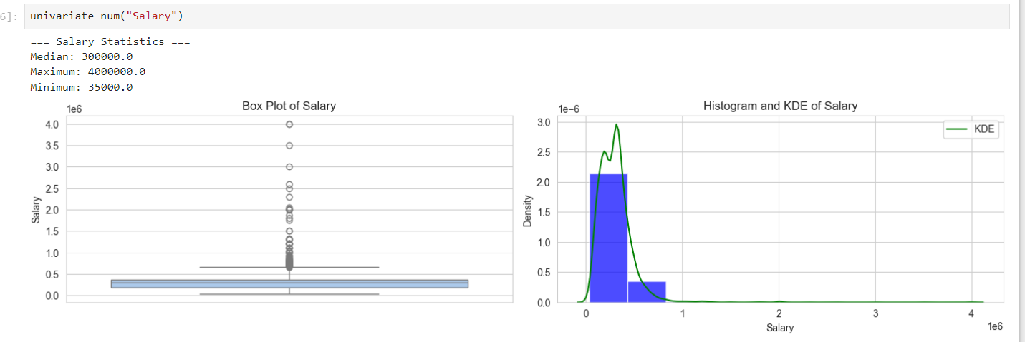
Target Variable – salary
OBSERVATIONS:
Box plot: Many high salary data points evident.
Histogram: Data skewed to the right.

Slide 9
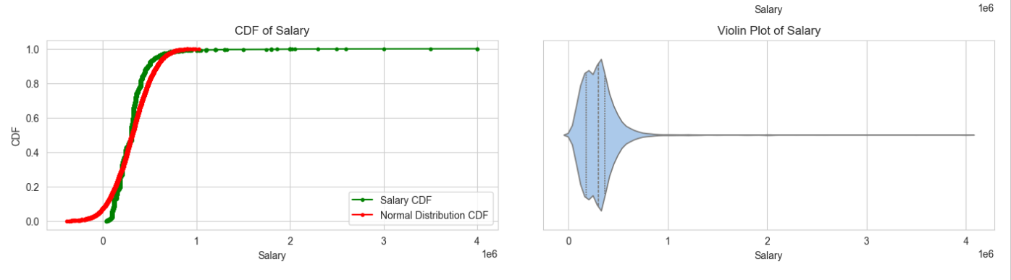
Target variable- Salary
OBSERVATIONS:
CDF: Shows significant skewness.
Violin plot: Concentration of high salary data points observed.

Slide 10
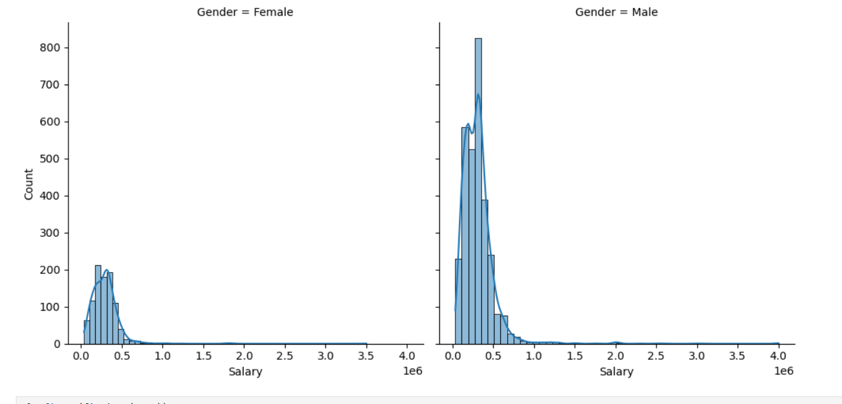
Observation:
Male persons are getting more salary as compared to Female

Slide 11
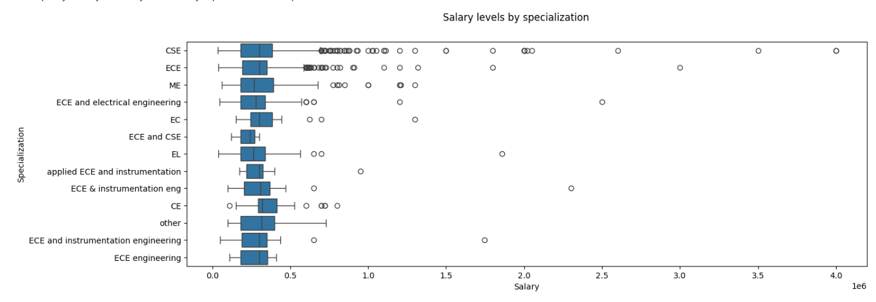
Salary Levels by Specialization CSE and ECS Specialized persons are getting more salaries

Slide 12
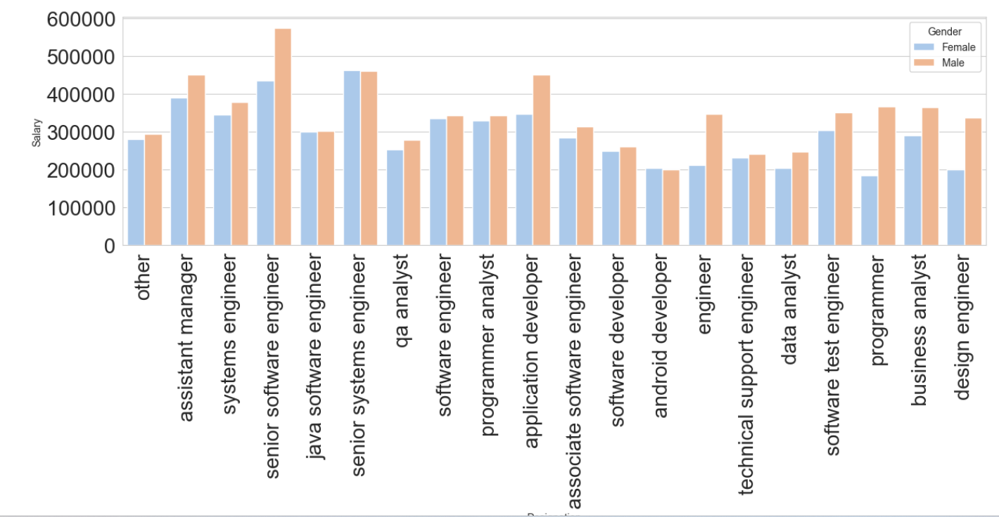
Salary By Designation
Senior software engineers are getting more salaries

Slide 13
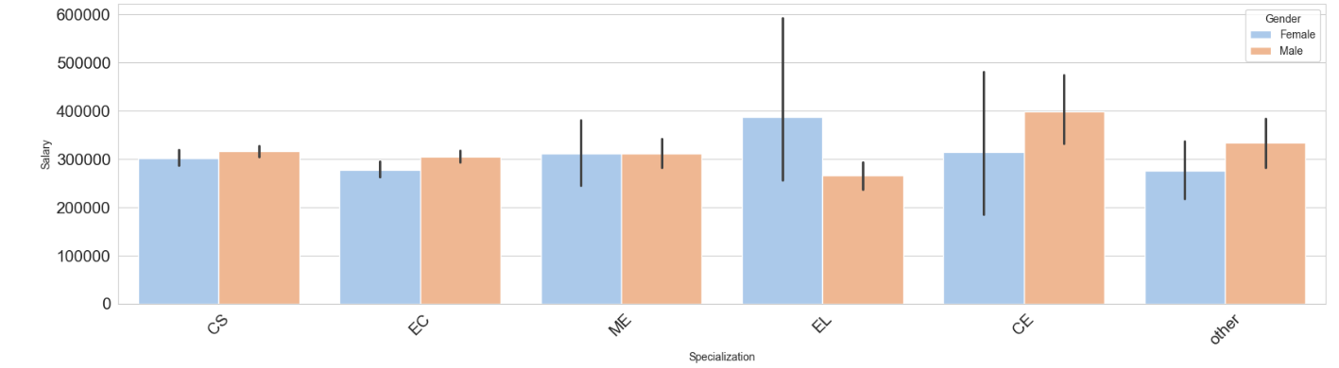
Salary by Study Specialization

Slide 14
OBSERVATION SUMMERY OF UNIVARIENT ANALYSIS
Job Placements: Bangalore emerges as the most favorable city for job placements, followed by Noida, Hyderabad, and Pune, while Mumbai and Kolkata are less preferred destinations.
Gender Distribution: The dataset exhibits an imbalance in terms of gender representation.
Educational Background: A significant proportion of students have graduated with a B.Tech degree, whereas there are fewer students with an M.Sc(Tech) qualification.
Graduation Years: The highest number of students graduated in 2013, with 2014 and 2012 following closely behind in terms of graduation frequency.
Overall, Bangalore appears to be the top choice for job placements, especially for individuals with a B.Tech degree, although the dataset shows an uneven gender distribution and fewer graduates with an M.Sc(Tech) qualification.

Slide 15
OBSERVATION SUMMERY OF BIVARIANTE ANALYSIS
Salary Distribution: Right-skewed.
Gender Equality: Similar distributions below 10 lakhs.
Specializations: Similar median salaries; CS/EC specializations earn higher.
Designations: Software Engineering is common; males dominate.
Role-Based Pay: Senior software engineers earn the most; females in Test Engineer roles earn more than males.
Experience vs. Salary: Median salaries peak around 3.5-5 lakhs; tenure distribution is skewed.
Gender Disparity: Differences in median experience, but not conclusive evidence for salary differences solely due to experience.

Slide 16
OVERALL OBSERVATION OF THIS EDA OF AMEO DATA IS
Job Placements: Bangalore, Noida, Hyderabad, and Pune are preferred for job placements, with Mumbai and Kolkata being less favored.
Gender Distribution: The dataset shows an imbalance in gender representation.
Educational Background: B.Tech graduates are predominant, with fewer M.Sc(Tech) graduates.
Graduation Years: Highest number of graduates in 2013, closely followed by 2014 and 2012.
Salary Distribution: Right-skewed, with similar distributions below 10 lakhs.
Specializations: Similar median salaries; CS/EC specializations earn higher.
Designations: Software Engineering is common; males dominate.
Role-Based Pay: Senior software engineers earn the most; females in Test Engineer roles earn more than males.
Experience vs. Salary: Median salaries peak around 3.5-5 lakhs; skewed tenure distribution.
Gender Disparity: Differences in median experience, inconclusive evidence for salary differences solely due to experience.

Slide 17

THANK YOU

